Slide 1



Chowgacha - Jhenaidah Model: Challenges and Achievement
Dr. Md.Emdadul Haque
Senior National Consultant C -J model replication committee

Slide 2
Comparative data of health facilities of different country of the world
SL NO | Country | Per capita health Expenditure per year by Govt. ($) | Doctors per 10000 Population | Nurse per 10000 Population | Beds per 10000 population | Out of pocket expenditure %
01 | USA | 9536 | 25.5 | 99 | 37 | 11.08
02 | UK | 4356 | 28.0 | 84 | 30 | 14.79
03 | Malaysia | 386 | 12.8 | 34 | 18 | 36.67
04 | Sri Lanka | 118 | 7.3 | 17.5 | 31 | 38.43
05 | India | 63 | 7.3 | 20.4 | 09 | 65.06
06 | Nepal | 44 | 08 | 4.7 | - | 60.41
07 | Pakistan | 38 | 08 | 06 | 06 | 66.40
08 | Bangladesh | 37 | *05 | *03 | *05 | 67.00
From internet 2018

Slide 3
Background History of C-J Model
The program starts in Chowgacha UHC in 1986.
Social mobilization program starts in Lohagara UHC , Narail from 1989 - 1995
In 1995-97 model activities started effectively.
In June 2008 ,MOH&FW declared the Chowgacha UHC as Model UHC of Bangladesh.
In 2010 D G of WHO recommended to replicate it.
Jhenaidah Sadar Hospital Model starts in 2012
C-J Model replicate in 2015 by MOHFW in 11 district hospital& 5 Upazilla UHC.
Replicating by the order of PM office, ADG(Admin) is the Chairperson within 2022.

Slide 4
A Hospital with a Vision …
Maximum utilization of Govt.
resources with
honesty and sincerity.
Integrated approach of
Administration, Community
Leaders .
Providing Effective services
through improved
management system.

Slide 5


Blood donation program stared in 16 December, 1996 in Chowgacha UHC
A seminar held on basic information system at Chowgacha Degree College in June, 1997. DC Jessore was the chief guest .

Slide 6


Health Education Session

Slide 7


Community supported volunteer working in ANC corner
Community Supported Volunteer Working as receptionist.

Slide 8

Upazila Health Complex
CHOWGACHA , JESSORE.
EOC Activities : 1997- 2011 (Hospital Delivery )

Slide 9
Community support in Chowgacha UHC
  Human resource 46
    Volunteer 26
    Cleaner&guard16
    Others 4
  A mobile phone
  Dustbins
  A reception center
  Tiles around the pillars of outdoor
  Beautification of road
  Others
    ANC, PNC, Growth Monitoring card
    Drugs for Arsenicosis
    Tyars of Ambulance
    Protocol board

Slide 10
Chowgacha Health Complex – improvement evaluation (1995-2017)
Subject | 1995 | 1996 | 2000 | 2007 | 2011 | 2017
Bed Occupancy Rate % | - | - | 93.5 | 201 | 208 | 171
ANC (First Visit)% | - | 16.3 (817) | 59 (2861) | 132 (7292) | 170 (8935) | 130 (6632)
Hospital Delivery Rate % | - | 2.1 (99) | 6.4 (422) | 38.1 (1899) | 98.4 (4413) | 66 (2932)
C-Section rate % | - | .02 (1) | 0.07 (3) | 9.6 (473) | 22.5 (1107) | 17
MMR/100,000 live births | 599 | 300 | 168 | 160 | 68 | 91
NMR/ 1000 live births | 42 | 47 | 23 | 21.5 | 18.2 | 16.6
IMR/ 1000 live births | 65 | 58 | 36 | 29.2 | 23.6 | 18.6
U5MR/ 1000 live births | 78 | 67 | 44 | 33.3 | 25.7 | 21.1

Slide 11
Achievement of Chowgacha Health Complex
    Chowgacha UHC declared as the model upazilla health complex in 2008.
  Chowgacha UHC became the best EOC center with 98.4% (4413) delivery rate. And 170%(8935) 1st ANC coverage in 2011.
  Chowgacha UHC achieved MDG target in 2009.
  Awarded for best performance in EOC form 2005 to 2014 and 2017,2018.
  Achieve Health ministers Award for its best performances in 2016 to 2018.
  The govt. taken the initiative to upgrade to 100 bedded in 2018.

Slide 12


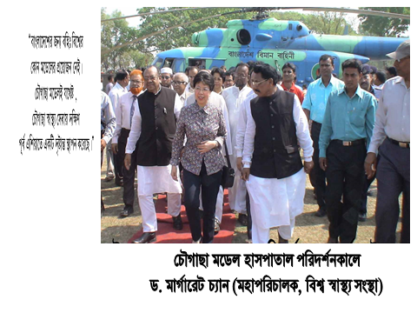
Report on national newspaper
14th October 2005
Visit of WHO DG on, 10th March,2010

Slide 13

100 kh¨v wewkó m`i nvmcvZvj, wSbvB`n

Slide 14


Innovative activities of Jhenaidah Sadar Hospital Page: 1
Community engagement
Big Cleaning Day

Slide 15


Internal Monitoring System
Meting of community support group committee
Monthly meeting schedule

Slide 16


Use of color code in official file arrangement

Slide 17







Changes in pediatric ward and waste management
Before
After

Slide 18
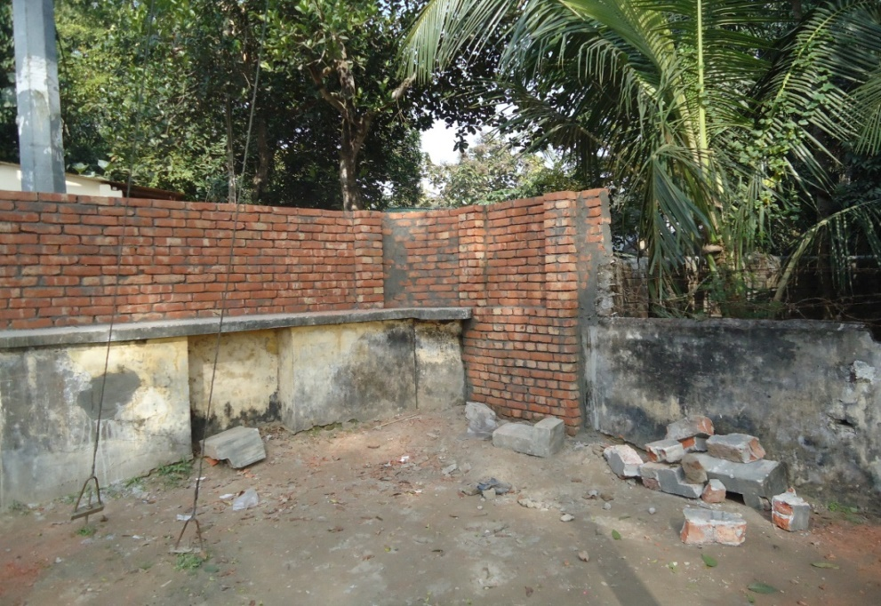

Improved security and recovery of valuable land
Campus protection
Recovered Valuable land after 50 years

Slide 19
Community Support in Jhenaidah Sadar Hospital
Human resource 56
  Cleaner 21
  Ayah & ward boy 22
  Guard 7
  Volunteer 3
  Trolley man 3
Paurasava supports
  Cleanliness
  Renovation of pediatric word
  A biochemistry analyzer.
Others
  A generator
  An inter-com

Slide 20

Sadar Hospital, Jhenaidah
Bed Occupancy Rate from 1998 to 2018

Slide 21
Emergency & Out Door, Indoor Service 1998 to 2018
Sadar Hospital, Jhenaidah

Slide 22
3 best performing EmOC Hospital in Khulna division - 2018
Sadar Hospital, Jhenaidah

Slide 23
Comparative data of revenue income (in Taka) from 2015 to 2018
Sadar Hospital, Jhenaidah

Slide 24
Achievements of Jhenaidah Sadar
Hospital
1. Active Community Participation is an example in Bangladesh.
2. Improved performance of all services.
3. Improved Cleanliness and Beautification of Campus.
4. Functioning of X-Ray service and Biochemistry investigation
5. Improved Security
6. Improved Financial Management
7. “Model ” is replicating in 11 district and 5 upazilla hospital
8. The hospital is awarded 7 times from 2013 to 2018.

Slide 25




Hospital Environment
Neonatal Care Unit

Slide 26



KAIZEN(CQI)
A frontline-based problem solving approach
Incremental but continuous progress

Slide 27


INNOVATION
Dramatic but intermittent progress
THE IDEAL
ACTUALITY
Higher standard achieved through innovation is subject to deterioration unless continuing efforts are made first to maintain it and then to improve it

Slide 28
KAIZEN PLUS INNOVATION
Desirable progress by combination of two opposing approaches
MAINTENANCE
INNOVATION
NEW STANDARD
KAIZEN
MAINTENANCE
INNOVATION

Slide 29

Thank You
Notes:
29

Slide 30
Characteristics of C-J Health Management Model
Successful leadership in health management
Personal and group skills in health care
Community engaged health management
Optimum use of government resources
Effective relation with local administration and with other government organizations
Improvement of security by community engagement
Improved maternal health care activities
Improved child health care activities
Ensuring corner-based health care

Slide 31
Characteristics of C-J Health Management Model
Birth and death recording, progress assessment and accountability by collecting information on all health indicators
Improving healthcare by unit management
Health awareness by health education
Cleanliness (Waste management) and beautification of the facility and premises.
Provision of safe blood transfusion for emergency needs
Zero tolerance against corruption
Implementation of the 5S KAIZEN-TQM for the improvement of health care
Improved financial management by establishing cash counter

